Slide 1
NAME: Samuela V Catherine
FINAL PROJECT: Music Recommendation System Machine Learning Project(KNN Algorithm)

Slide 2
PROJECT TITLE
Music Recommendation System Machine Learning Project(KNN Algorithm)

Slide 3

AGENDA
The objectives for a music recommendation system machine learning project using the K-Nearest Neighbors (KNN) algorithm could include: 1. Data Collection: Gather a comprehensive dataset containing information about users, their music preferences, and features such as genre, artist, album, rating, etc. 2. Data Preprocessing: Clean and preprocess the dataset by handling missing values, normalizing features, and encoding categorical variables to prepare it for training the KNN algorithm. 3. Model Training: Implement the KNN algorithm to train the recommendation system on the preprocessed dataset, specifying the number of neighbors to consider and tuning hyperparameters for optimal performance. 4. Evaluation Metrics: Evaluate the performance of the recommendation system using metrics such as accuracy, precision, recall, and F1 score to assess its effectiveness in providing relevant music recommendations to users.
3/21/2024 Annual Review

Slide 4
5. Personalization: Develop a system that can provide personalized music recommendations based on individual user preferences and behavior, enhancing the user experience and engagement. 5. Personalization: Develop a system that can provide personalized music recommendations based on individual user preferences and behavior, enhancing the user experience and engagement. 6. Scalability: Ensure that the recommendation system is scalable and can handle a large volume of users and music data efficiently to provide real-time recommendations. 7. User Interface: Design a user-friendly interface that allows users to interact with the recommendation system, provide feedback on recommendations, and explore new music based on their interests. 8. Continuous Improvement: Implement mechanisms for feedback collection and model retraining to continuously improve the recommendation system's accuracy and relevance over time. By setting clear objectives for the music recommendation system machine learning project using the KNN algorithm, you can effectively plan and execute the development of a personalized and efficient recommendation system for music enthusiasts.

Slide 5

PROBLEM STATEMENT
Develop a music recommendation system that utilizes the K-Nearest Neighbors algorithm to provide personalized music recommendations to users based on their preferences and listening history. The system should analyze a dataset of user music preferences, including features such as genre, artist, album, and rating, to identify the most similar users or items and suggest music that aligns with their tastes. The goal is to create an efficient and accurate recommendation system that enhances the user experience by offering tailored music suggestions.

Slide 6

PROJECT OVERVIEW
This project aims to develop a music recommendation system using the K-Nearest Neighbors algorithm to provide personalized music suggestions to users based on their preferences. The system will analyze a dataset containing user music preferences, including features such as genre, artist, album, and rating, to identify similar users or items and recommend music that aligns with their tastes. Key Components: 1. Data Collection: Gather a dataset of user music preferences to train the recommendation system. 2. Data Preprocessing: Clean and preprocess the data, normalize features, and split into training and testing sets. 3. Model Training: Implement the KNN algorithm to train the recommendation system on the training data.

Slide 7
4. Recommendation Generation: Use the trained model to generate personalized music recommendations for users based on their preferences. 5. Evaluation: Assess the performance of the recommendation system using metrics such as accuracy, precision, recall, and F1 score. 6. Deployment: Deploy the music recommendation system to provide real-time recommendations to users. Expected Outcome: By the end of this project, we aim to create an efficient and accurate music recommendation system that enhances the user experience by offering tailored music suggestions based on their tastes and preferences. The system will provide a seamless and personalized music discovery experience for users, improving engagement and satisfaction.

Slide 8

WHO ARE THE END USERS?
The end users for a music recommendation system machine learning project utilizing the K-Nearest Neighbors (KNN) algorithm could include: 1. Music enthusiasts: Individuals who are passionate about music and are looking for personalized recommendations to discover new artists, genres, or songs that align with their tastes. 2. Streaming platform users: Subscribers of music streaming services who rely on recommendations to enhance their listening experience and discover new music tailored to their preferences. 3. Music app users: Users of music applications on various devices who seek personalized recommendations to create playlists, explore new music, and enjoy a curated listening experience. 4. Music industry professionals: Artists, producers, and music labels who can benefit from insights generated by the recommendation system to understand user preferences, trends, and popular music choices. Overall, the end users of a music recommendation system powered by the KNN algorithm are individuals and professionals in the music industry who value personalized music suggestions and seek to enhance their music listening experience.

Slide 9

YOUR SOLUTION AND ITS VALUE PROPOSITION
Solution: The solution for the music recommendation system machine learning project using the K-Nearest Neighbors (KNN) algorithm involves implementing the following steps: 1. Data Collection: Gather a dataset containing user music preferences, including features such as genre, artist, album, and rating. 2. Data Preprocessing: Clean and preprocess the data, normalize the features, and split it into training and testing sets. 3. Model Training: Train the KNN algorithm on the training data, specifying the number of neighbors to consider. 4. Recommendation Generation: Use the trained model to make music recommendations for users based on their preferences. The algorithm will find the K most similar users or items and suggest music that aligns with their tastes. 5. Evaluation: Evaluate the performance of the recommendation system using metrics such as accuracy, precision, recall, and F1 score to ensure its effectiveness.

Slide 10
Value Proposition: The music recommendation system using the KNN algorithm offers several key value propositions: 1. Personalized Recommendations: The system provides personalized music suggestions to users based on their individual preferences and listening history, enhancing their overall music discovery experience. 2. Efficient and Accurate: By leveraging the KNN algorithm, the system can efficiently identify the most similar users or items and recommend music that aligns with the user's tastes, leading to accurate recommendations. 3. Enhanced User Experience: The tailored music recommendations enhance the user experience by offering relevant and engaging content, increasing user satisfaction and engagement with the platform. 4. Scalability: The KNN algorithm is scalable and can handle large datasets, making it suitable for platforms with a wide range of music content and user preferences. Overall, the music recommendation system using the KNN algorithm provides a valuable solution for delivering personalized music recommendations to users, improving user engagement and satisfaction with the platform.

Slide 11

THE WOW IN YOUR SOLUTION
In our solution for the music recommendation system machine learning project using the K-Nearest Neighbors (KNN) algorithm, the "wow" factor lies in the personalized and tailored music recommendations that it provides to users. By leveraging the power of KNN, our system can analyze user preferences and listening history to identify the most similar users or items, ensuring that the music suggestions are highly relevant and aligned with each user's individual tastes. Additionally, our system offers a seamless and user-friendly experience, allowing users to discover new music that resonates with them without the need for manual searching or browsing. The efficiency and accuracy of our recommendation system enhance the overall user experience, making it a valuable tool for music enthusiasts looking to explore new artists, genres, and songs. Overall, the "wow" factor in our solution lies in its ability to deliver personalized music recommendations that delight users and enhance their music listening experience, all powered by the sophisticated K-Nearest Neighbors algorithm.

Slide 12
MODELLING
To model a music recommendation system using the K-Nearest Neighbors (KNN) algorithm, you can follow these steps: 1. Data Collection: Gather a dataset containing information about users and their music preferences. This dataset should include features such as genre, artist, album, rating, etc. 2. Data Preprocessing: Clean and preprocess the data by handling missing values, normalizing numerical features, and encoding categorical variables. 3. Split Data: Divide the dataset into training and testing sets to evaluate the performance of the recommendation system. 4. Implement KNN Algorithm: Train the KNN algorithm on the training data, specifying the number of neighbors to consider. You can use libraries like scikit-learn in Python to implement the KNN algorithm.

Slide 13
5. Model Evaluation: Evaluate the performance of the recommendation system using metrics such as accuracy, precision, recall, and F1 score. You can also use techniques like cross-validation to assess the model's generalization capabilities. 6. Hyperparameter Tuning: Fine-tune the hyperparameters of the KNN algorithm, such as the number of neighbors, to optimize the model's performance. 7. Make Recommendations: Use the trained KNN model to make music recommendations for new users based on their preferences. The algorithm will find the most similar users or items and suggest music that aligns with their tastes. By following these steps, you can successfully model a music recommendation system using the K-Nearest Neighbors algorithm in a machine learning project.

Slide 14
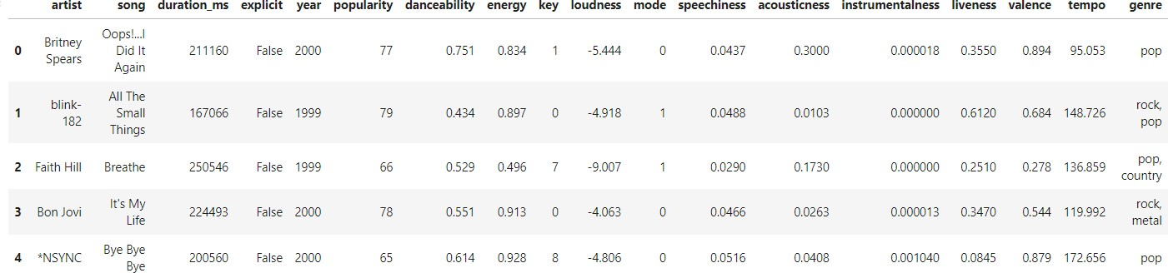
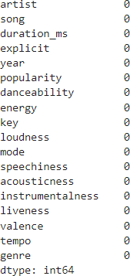
RESULTS
#DISPLAYING THE HEAD OF THE DATASET
#CHECKING FOR NULL VALUES AND REMOVING

Slide 15
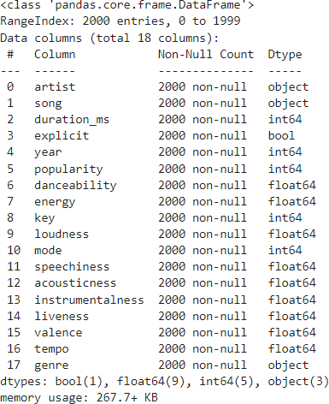
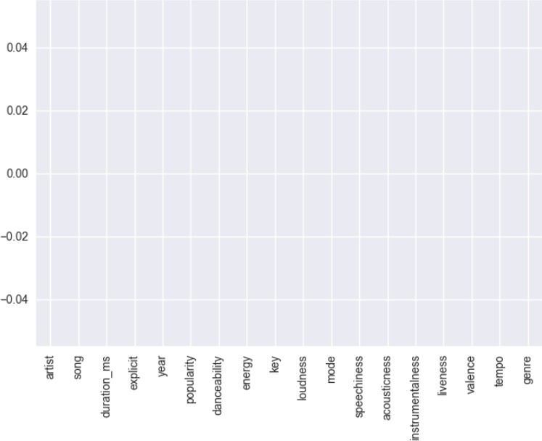
#VIEWING THE DATATYPE OF THE DATASET
#SHOWING THE NULL VALUE

Slide 16
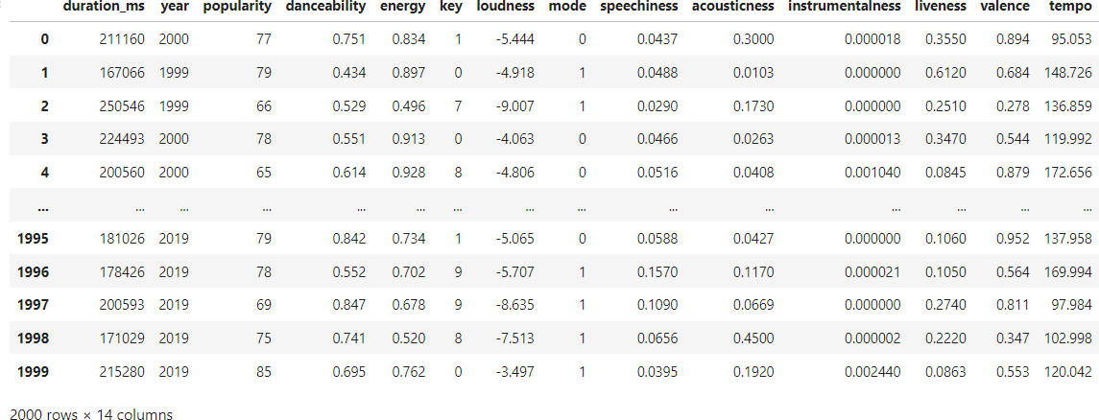
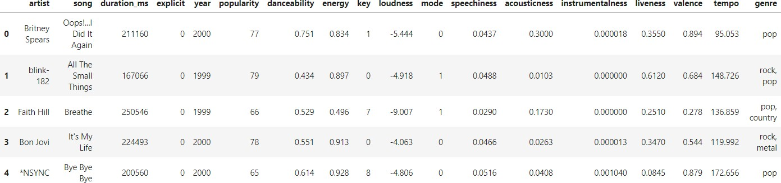
#SELECTING THE COLOUMNS WHICH HAVE NUMERICAL VALUES
#CHANGING THE EXPLICIT VALUE INTO INT VALUES

Slide 17
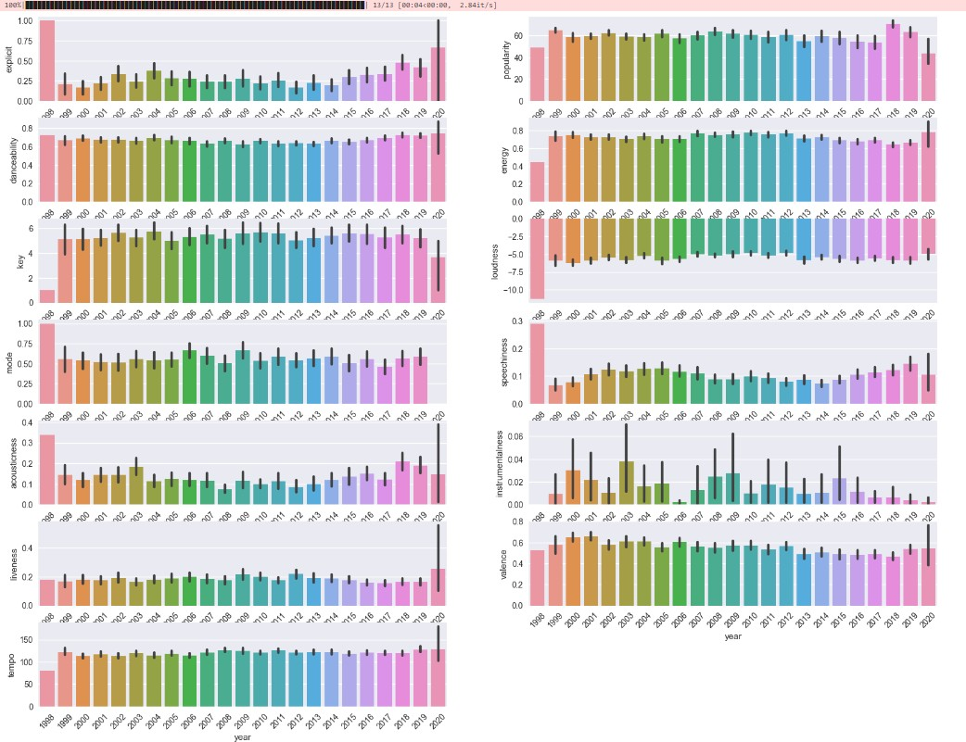
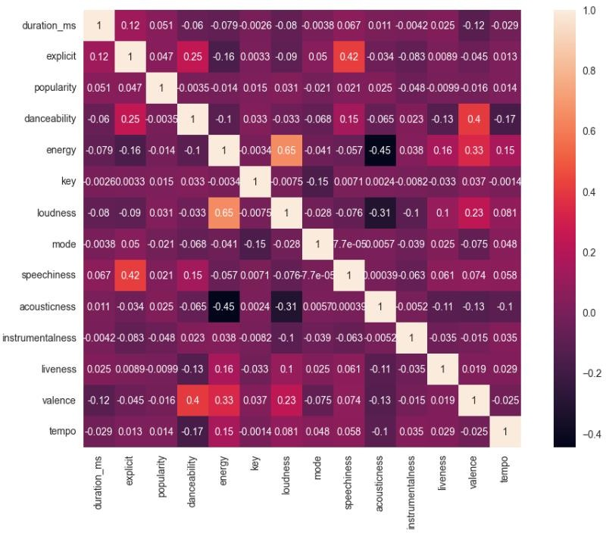
#DATA VISUALIZATION FOR THE DATA IN THE DATASET
#VISUALISING THE DATA AS HEATMAP

Slide 18
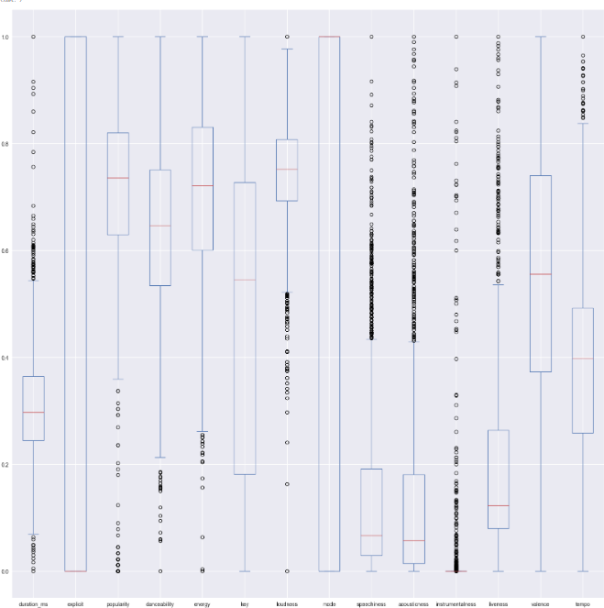
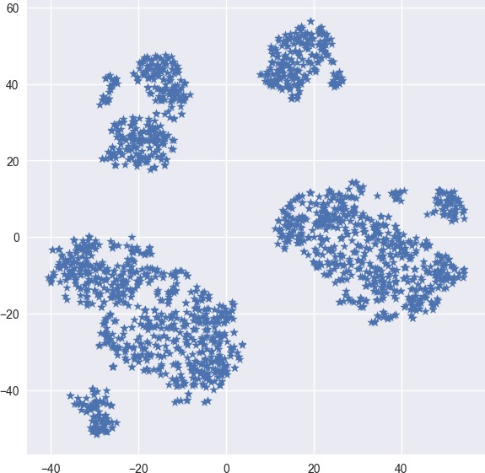
#PLOTTING BARPLOT FOR ALL THE COLUMNS BASED ON THE YEAR
#DATA VISUALISATION USING t-SNE

Slide 19
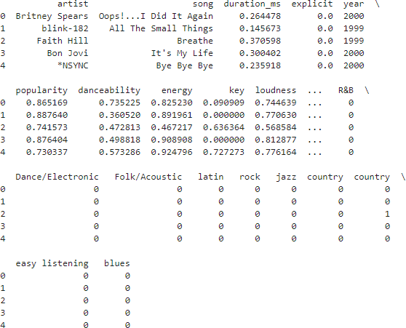
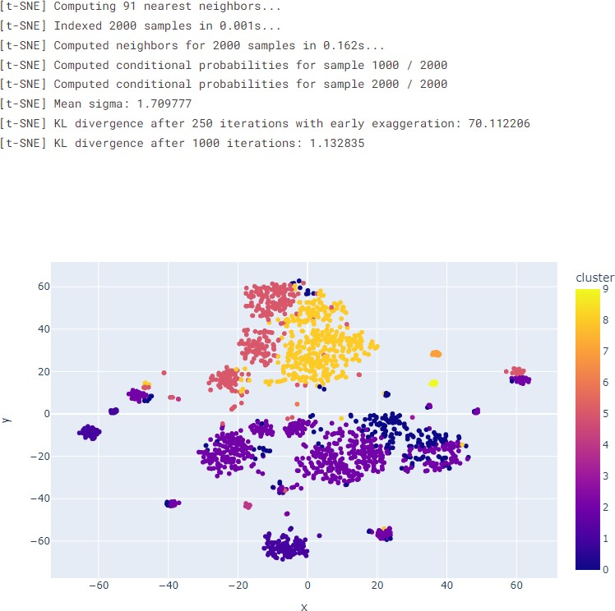
#ENCODING INTO A UNIQUE GENRE
#VISUALISING THE CLUSTER DATA IN t-SNE

Slide 20


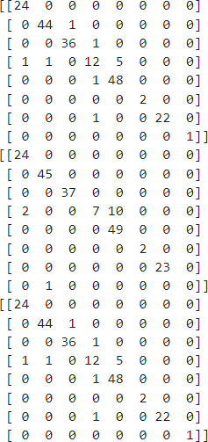
#TRAINING THE MODEL
#AFTER TRAINING THE DATA , COMPARING WITH THE
RESPECTIVE K VALUE TO SEE THE ACCURACY OF THE MODEL
#CALCULATES AND PRINTS THE CONFUSION MATRICES FOR THREE DIFFERENT SETS OF PREDICTIONS (Y_PRED_1,
Y_PRED_5, Y_PRED_10) COMPARED TO THE TRUE LABELS Y_VALID.

Slide 21
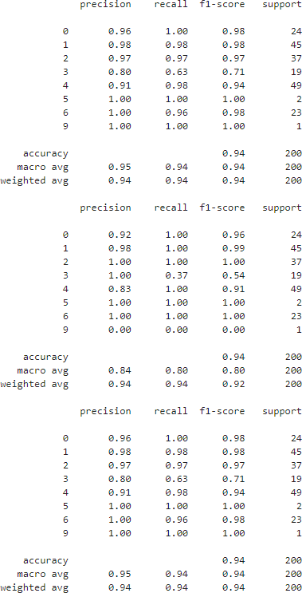
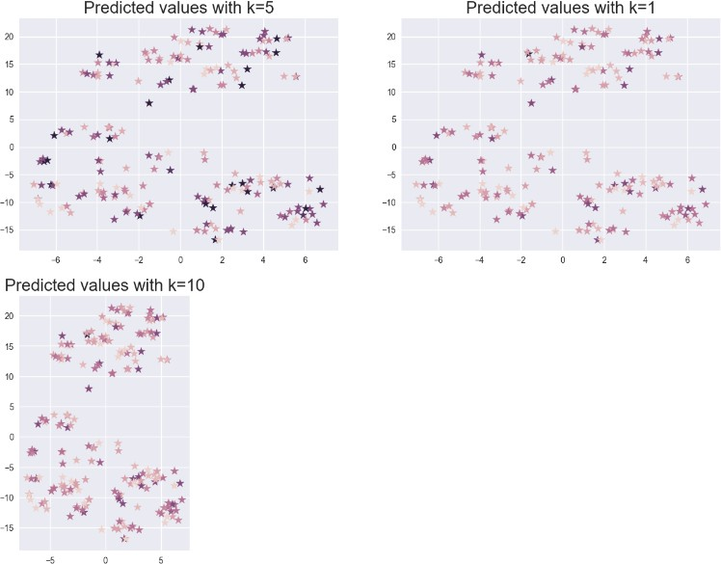
#CLASSIFICATION_REPORT
#SCATTER PLOT FOR THE PREDICTED VALUES

Slide 22
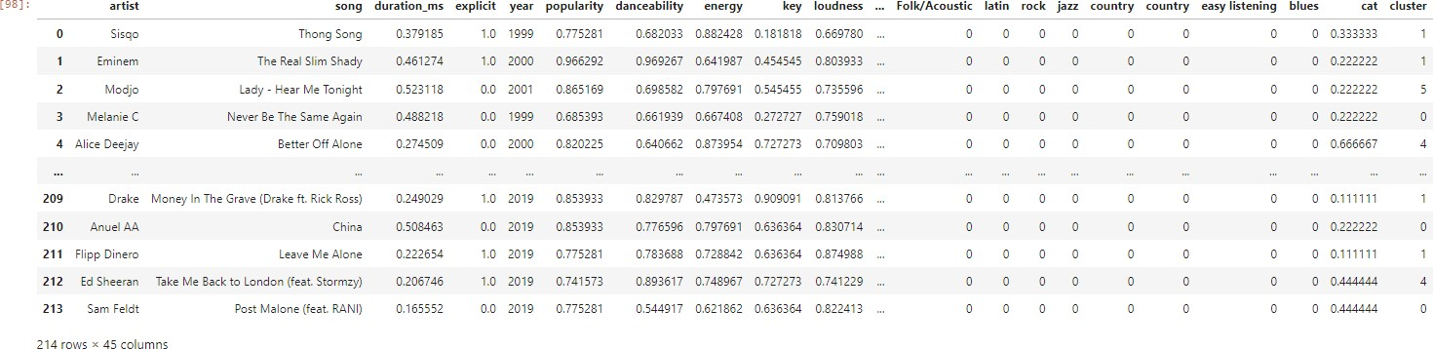
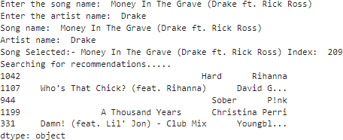
#MERGING THE X_TEST VALUE TO THE ACTUAL DATASET
#FINAL_OUTPUT

